Slide 1

Dr. Burger Digital Transformation
Executive Summary

Slide 2
Executive Overview
Comprehensive 24-month transformation roadmap
From traditional QSR to digital food service platform
Four strategic phases: Foundation → Expansion → Integration → Innovation
Key outcomes: Revenue growth, customer engagement, operational efficiency
Total investment: $26M with expected 3-year ROI of 165%

Slide 3

Digital Transformation Vision
Vision Statement: To transform Dr. Burger from a traditional fast-food chain into a digitally-enabled food service platform that delivers personalized experiences, creates new revenue streams, and builds deeper customer relationships through innovative technology integration.
Guiding Principles:
Customer-centric design
Data-driven decision making
Platform business model
Seamless omnichannel experiences
Operational excellence through technology

Slide 4
Business Challenges & Opportunities
Challenges:
Opportunities
Growing competition from digital-first delivery platforms
Changing consumer expectations for convenience and personalization
Pressure on traditional revenue streams and margins
Legacy systems limiting business agility
Expand digital ordering and engagement channels
Create subscription and platform revenue models
Build deeper customer relationships through personalization
Optimize operations through digital automation
Enable rapid innovation and market adaptation

Slide 5
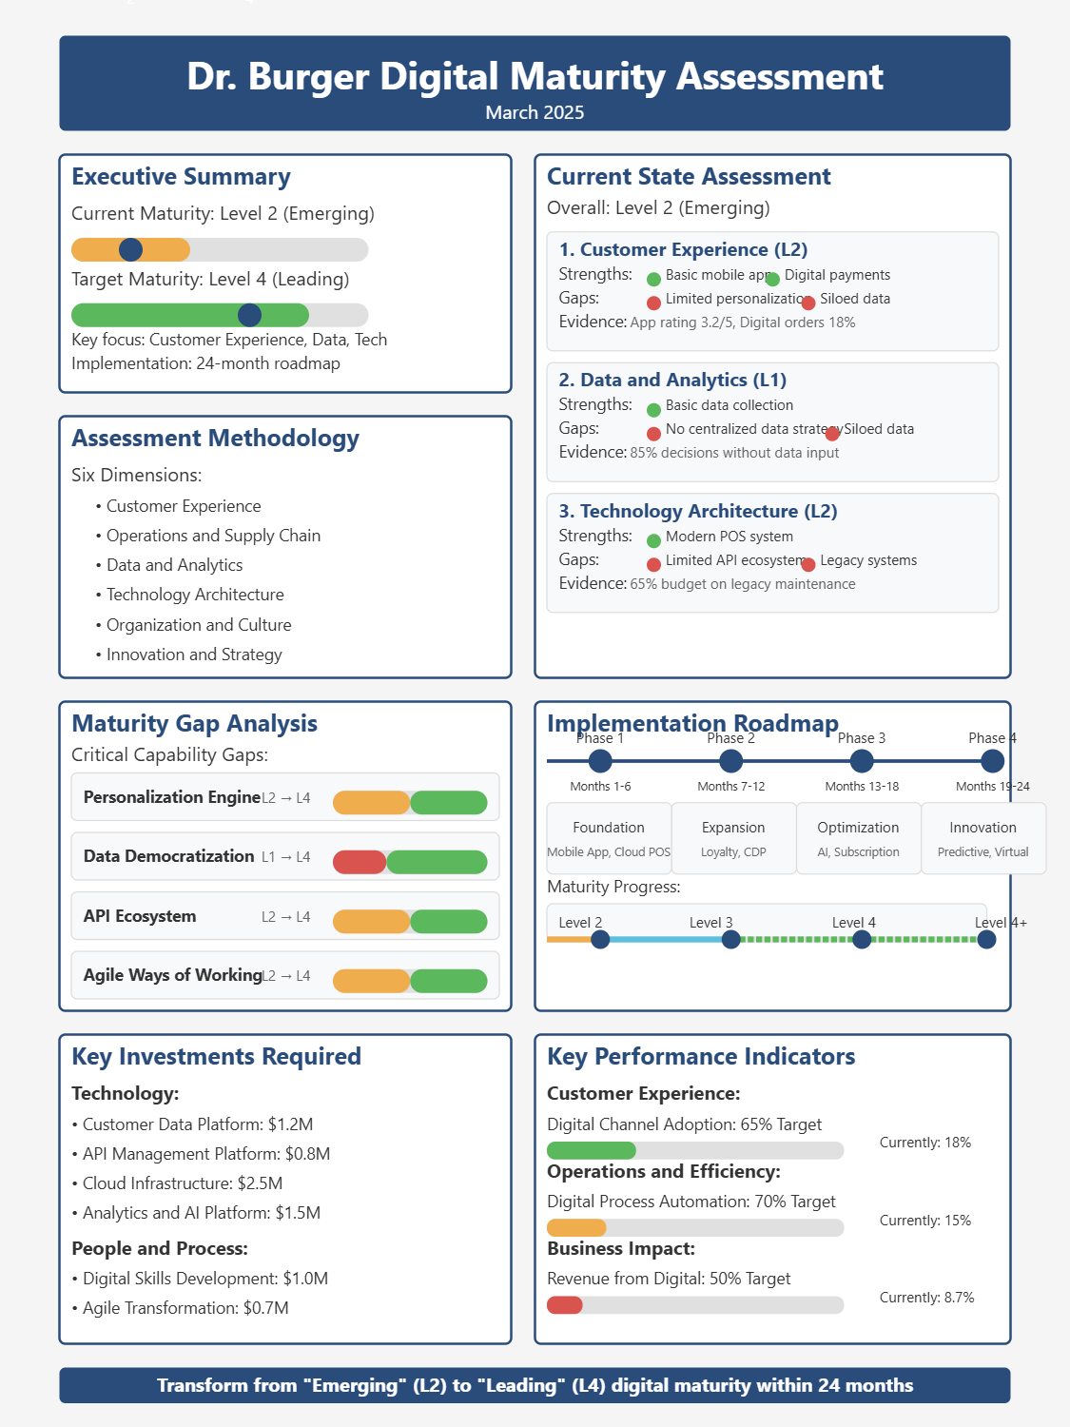
Digital Maturity Assessment
Current state: Level 2 (Emerging) on 5-point scale
Target state: Level 4 (Leading) within 24 months
Key gaps in data capabilities, technology architecture, and digital organization
Foundation for measuring transformation progress

Slide 6
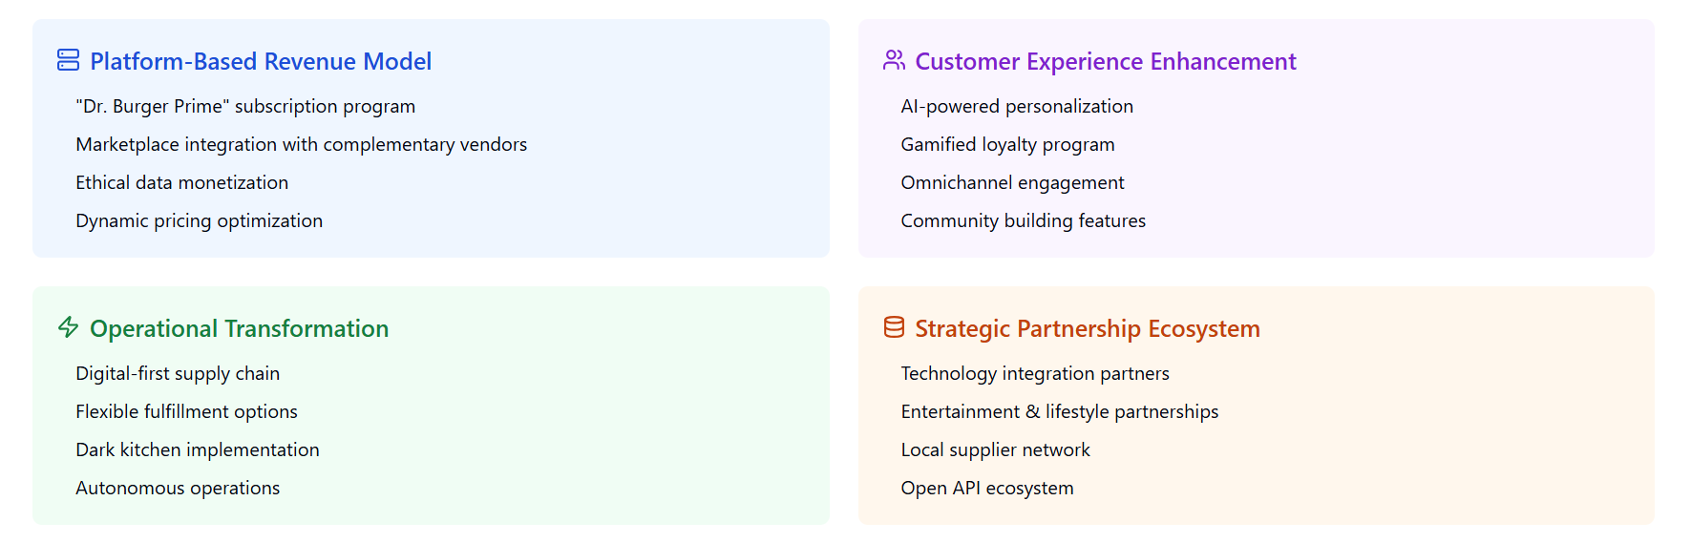
Four Strategic Pillars

Slide 7
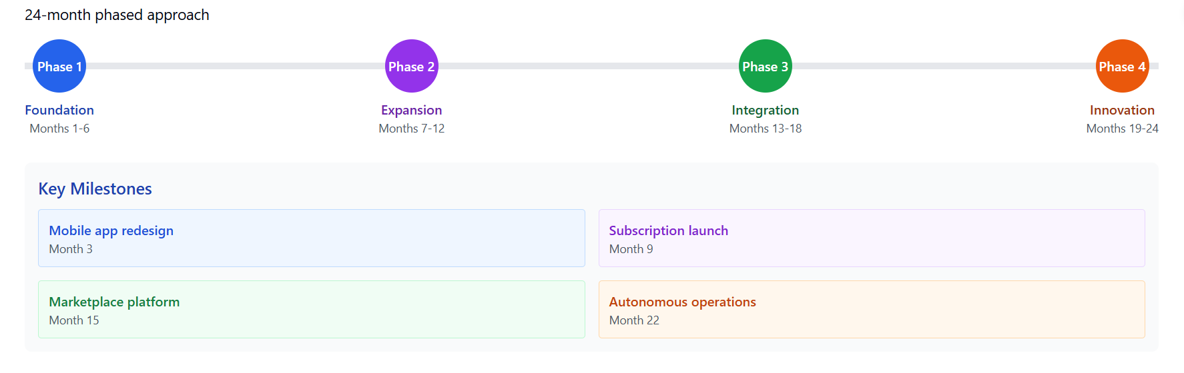
Implementation Roadmap

Slide 8
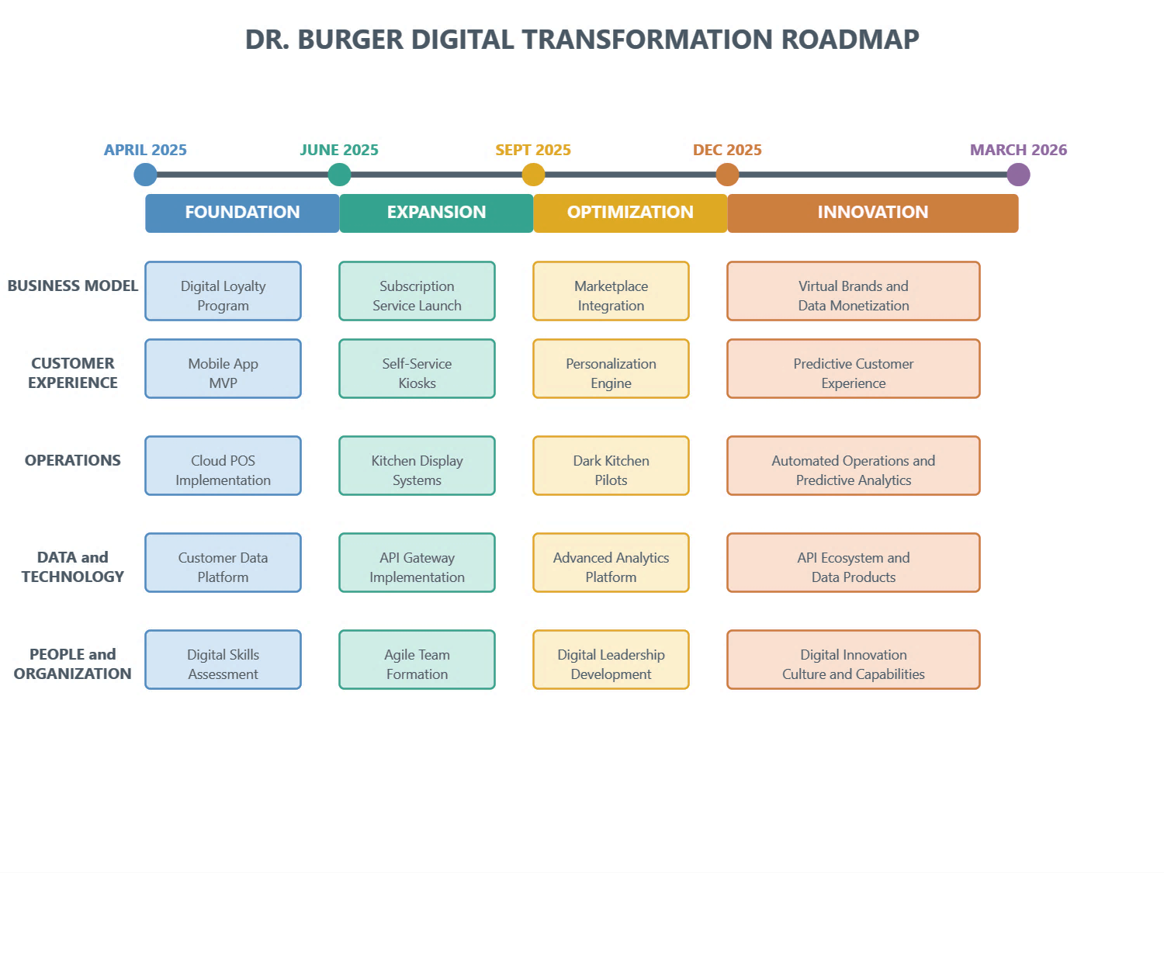
Transformation Journey Roadmap

Slide 9
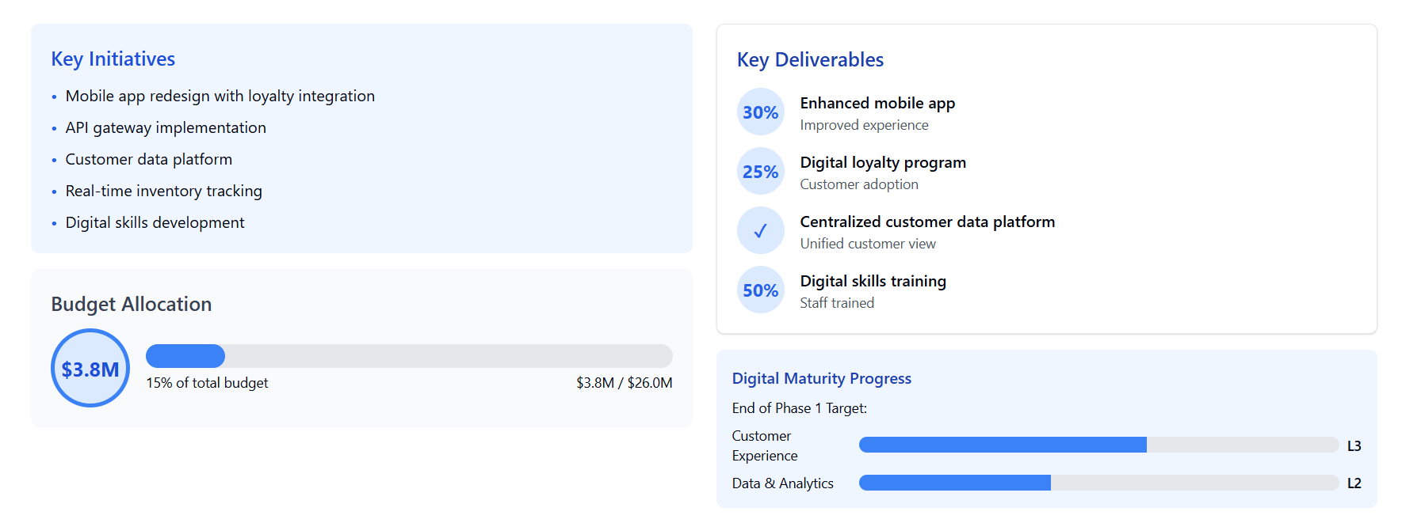
Phase 1 - Foundation (Months 1-6)

Slide 10
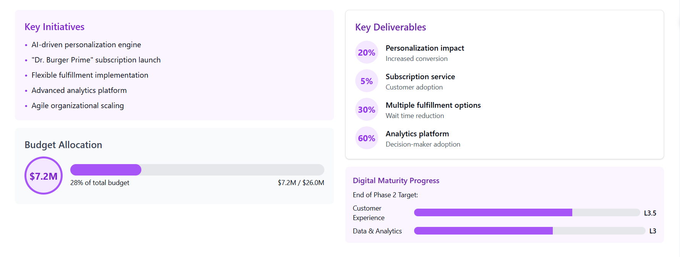
Phase 2 - Expansion (Months 7-12)

Slide 11
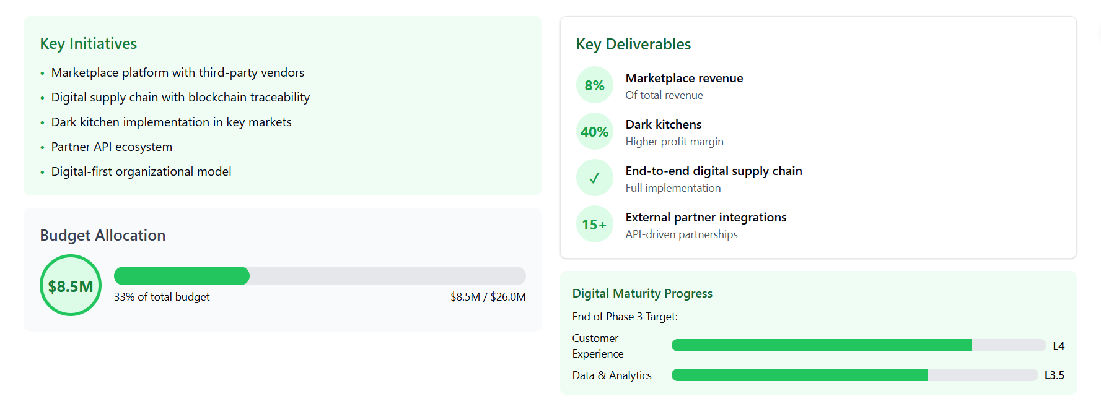
Phase 3 - Integration (Months 13-18)

Slide 12
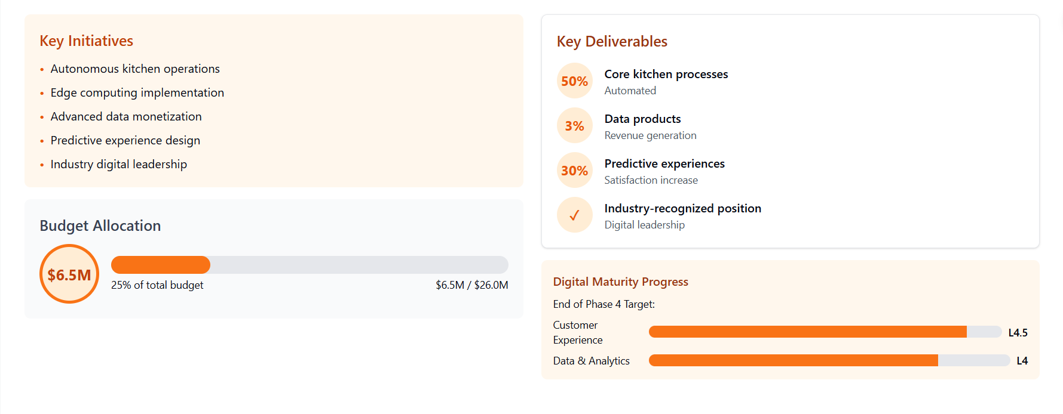
Phase 4 - Innovation (Months 19-24)

Slide 13
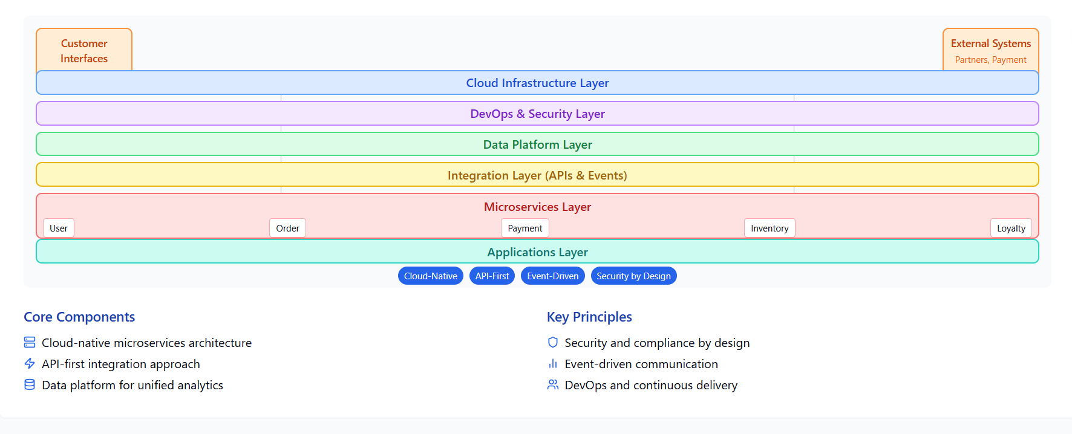
Technology Architecture

Slide 14
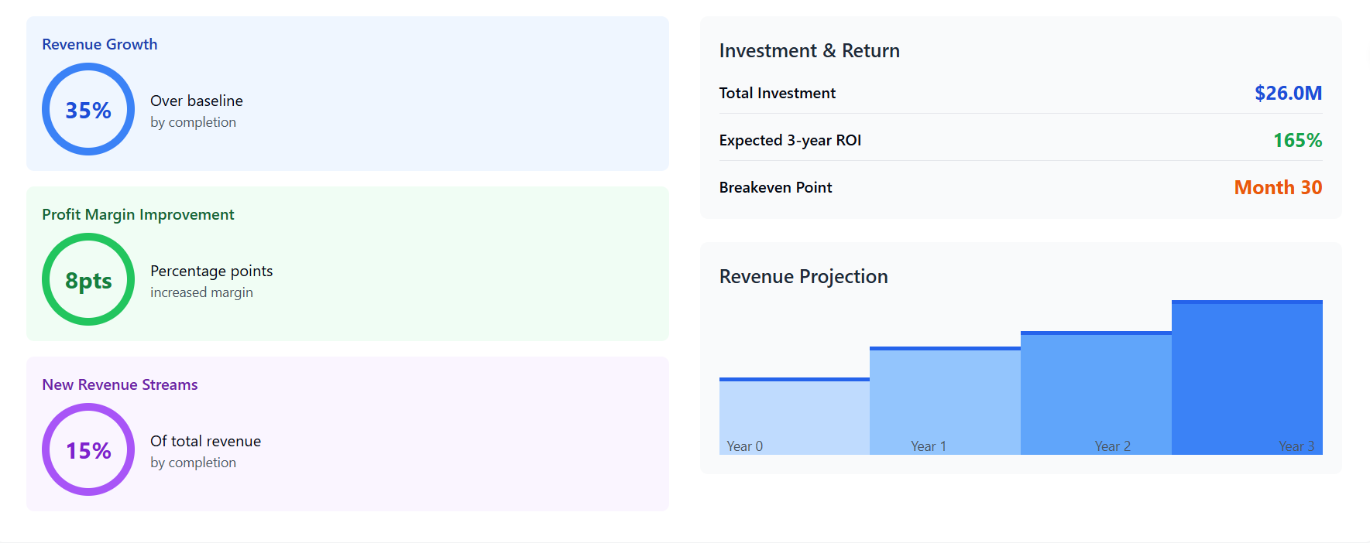
Financial Impact

Slide 15
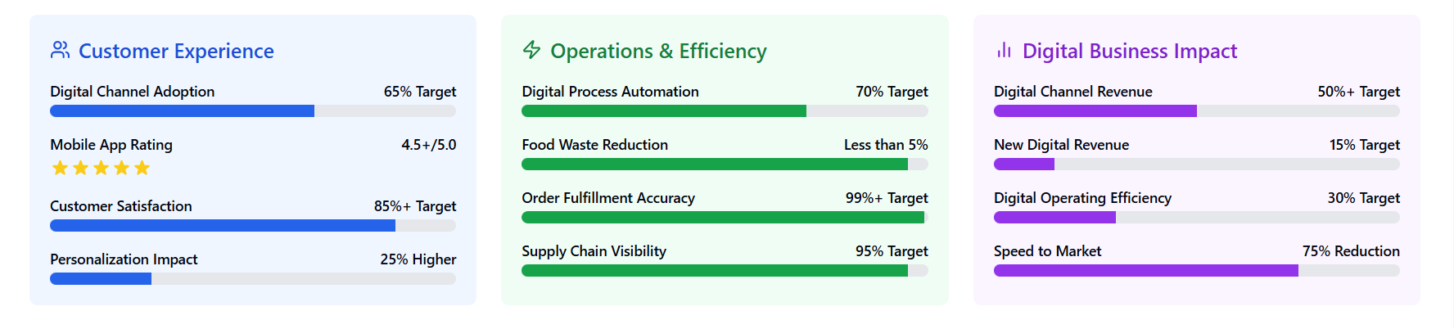
Key Performance Indicators

Slide 16
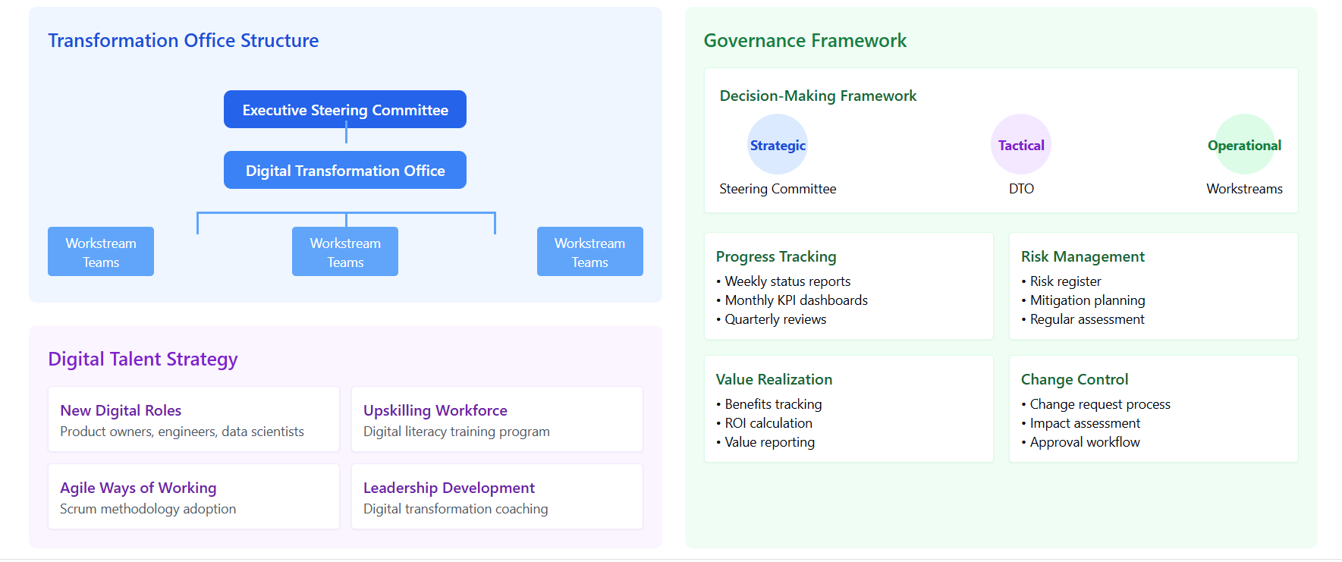
Organization & Governance

Slide 17
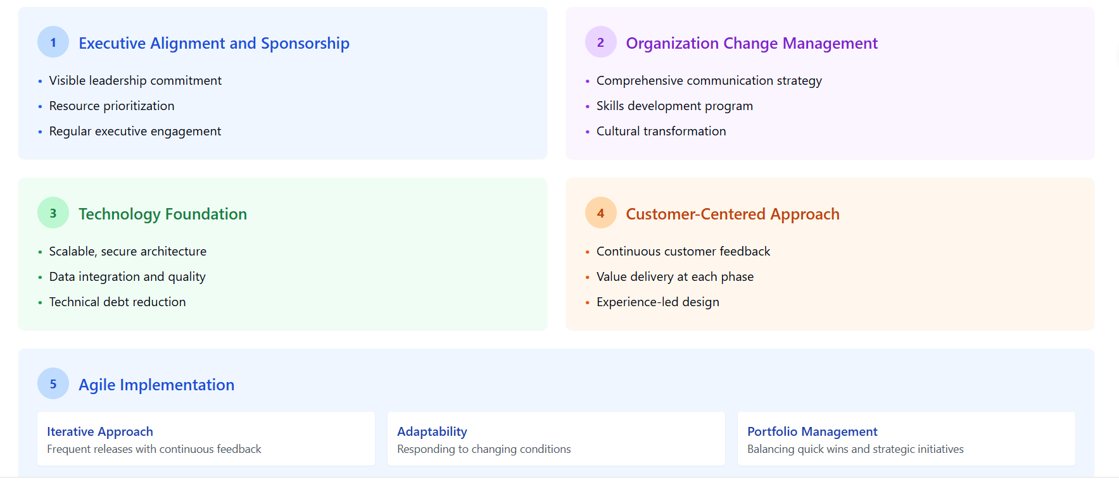
Critical Success Factors

Slide 18
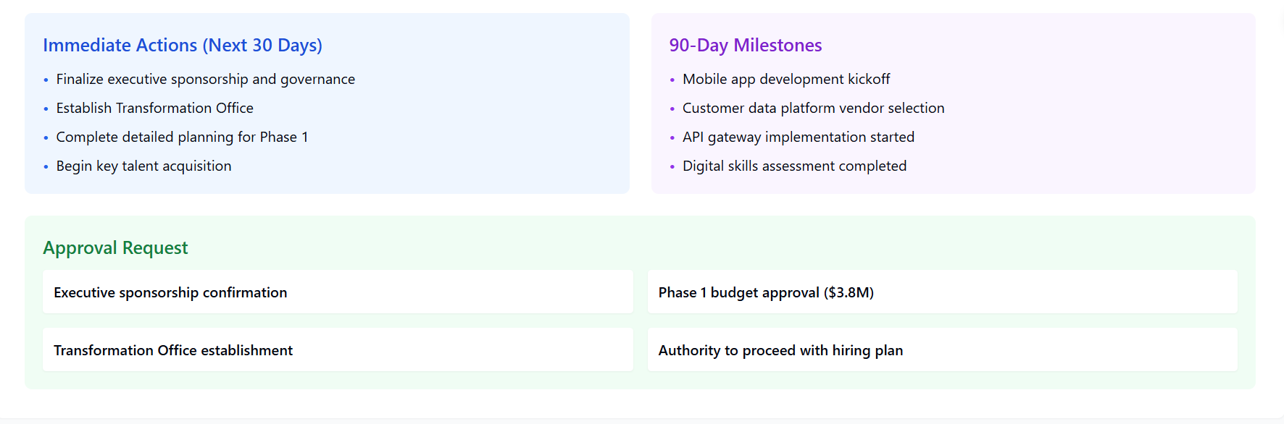
Implementation Timeline & Next Steps

Slide 19
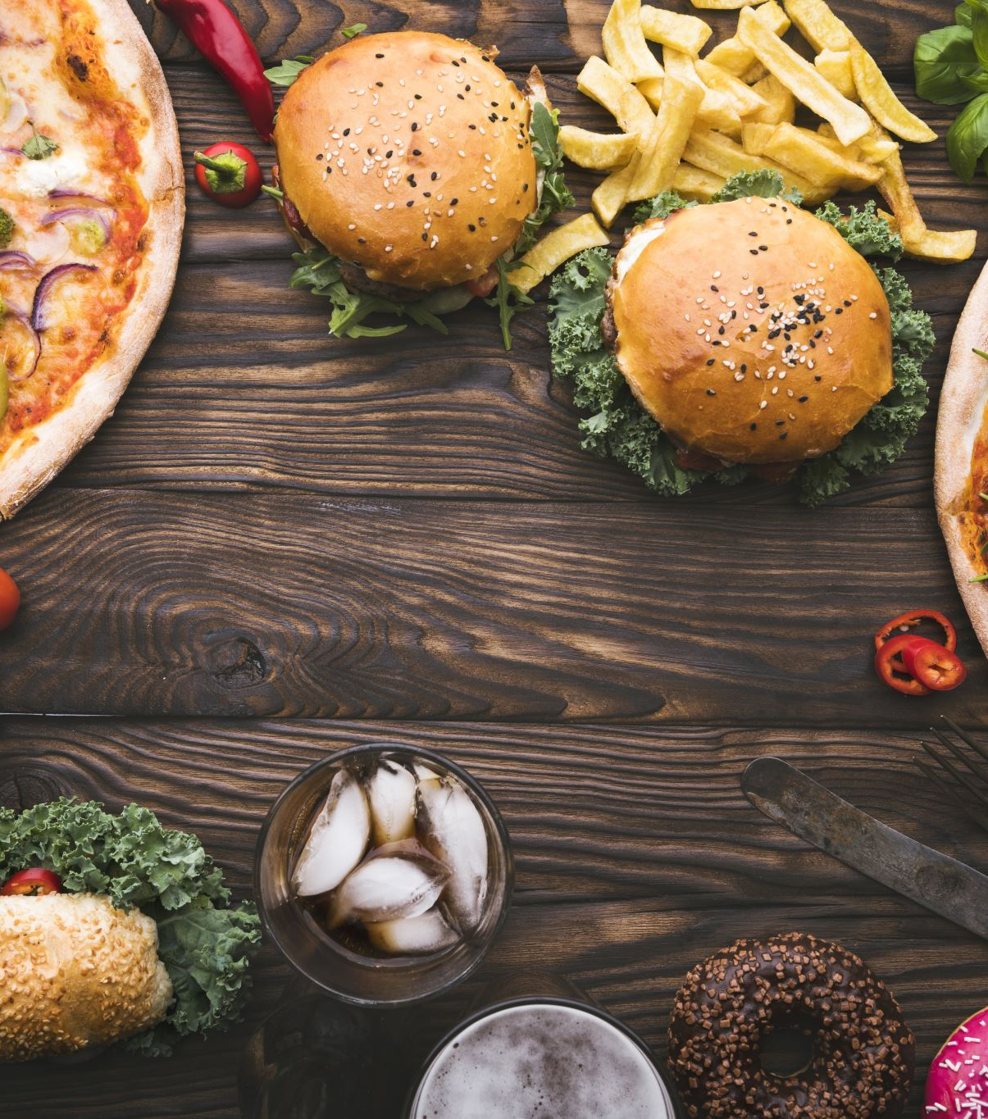
Thank You
Questions?
We welcome your feedback and questions
Dr. Burger Digital Transformation Team
Sandipan Ghosh
Atul Vijay
Dr Gaurav Taneja
Subhasish Sinha
Darpan Sah

